Slide 1
Lecture 2: Science and Measurements
California State University, Fullerton
2023 Fall Semester – Chem 123

Slide 2

QUESTIONS, COMMENTS, AND CONCERNS?

Slide 3
Outline
Updated syllabus
Previous lecture - Classification and properties of Matter and Scientific Method
Ch. 1: Science and Measurements
Significant Digits
Making measurements in lab
Dimensional Analysis – Density and Temperature

Slide 4
Updated syllabus
Grade Breakdown Out of 100%
1st midterm 10%
2nd midterm 20%
3rd midterm 20%
1 Final exam 30% - Cumulative
Homework+in-class assignments 20%
EC Opportunity, stay tune

Slide 5
Updated syllabus
Homework+in-class assignments
Each online homework assignment will be scaled to 10 points. If you score 90% on the homework assignment, then you will get the full 10 points credit.
Any score below 90% will be scaled out of 10 points + 1 point. If you get 85% on the online homework assignment, the homework score will be 9.5 (10*0.85 + 1).
Additional in-class assignments that you will upload onto canvas to receive credit

Slide 6
Canvas survey
Fill out the Canvas survey and it will help to gauge where is everyone at academically – mathematics, chemistry, physics, etc.

Slide 7
Outline
Updated syllabus
Previous lecture - Classification and properties of Matter and Scientific Method
Ch. 1: Science and Measurements
Significant Digits
Making measurements in lab
Dimensional Analysis – Density and Temperature

Slide 8
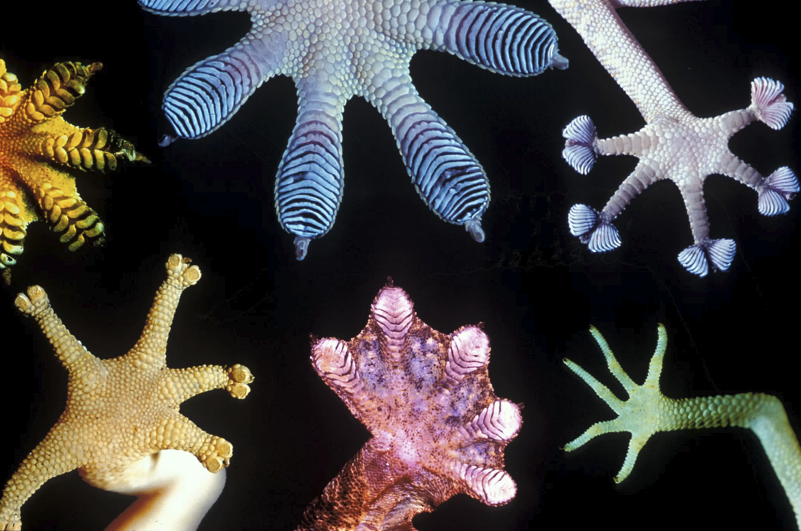
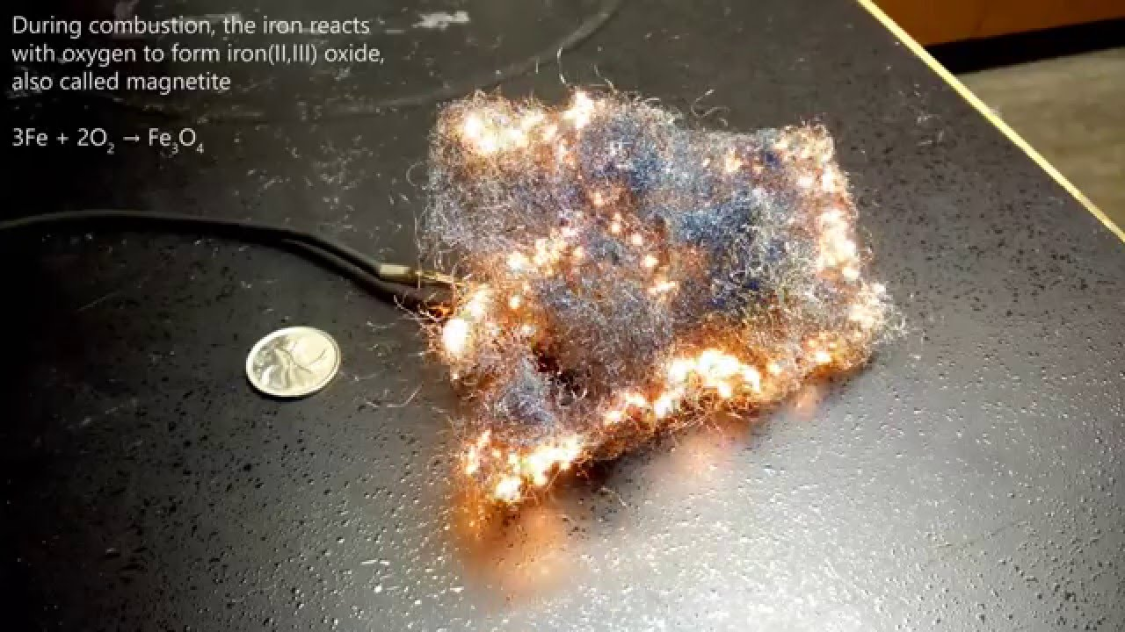
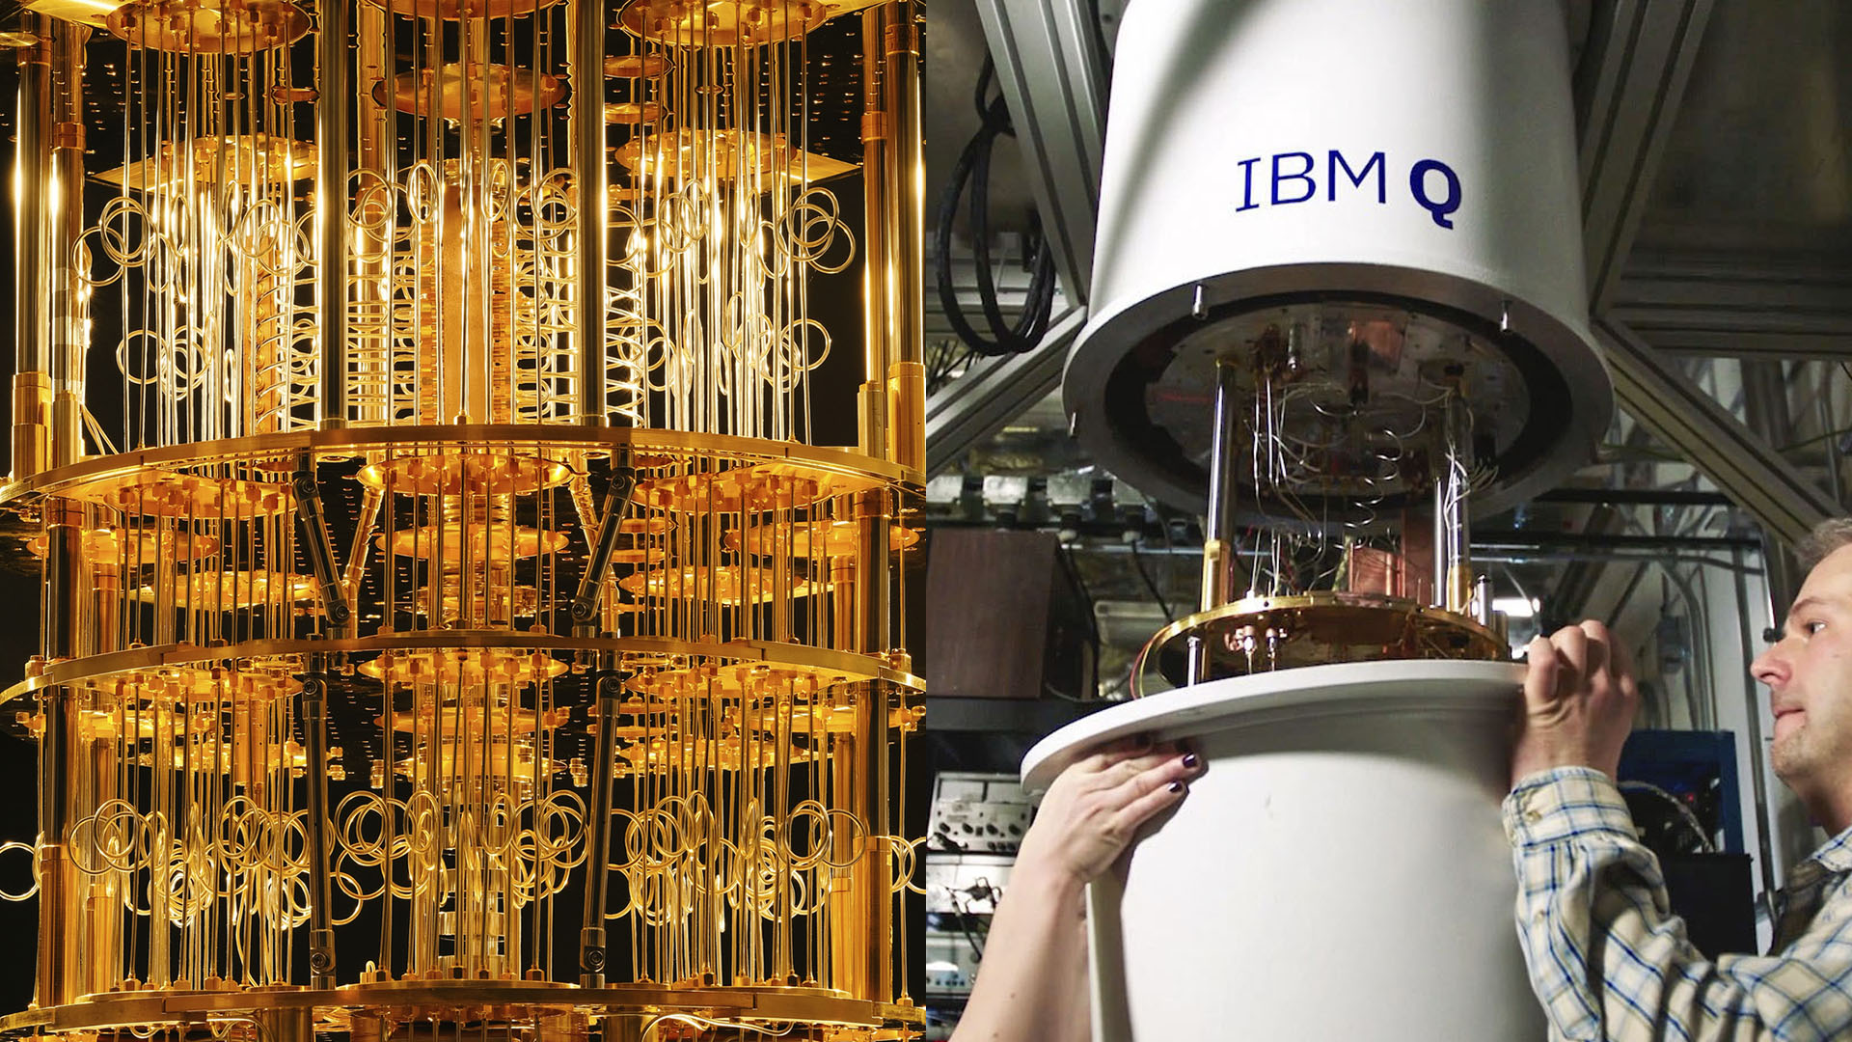
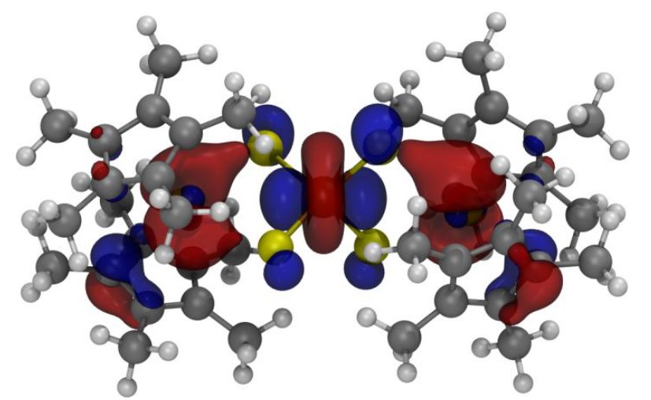
Chemistry: study of matter and energy
Gecko's feet
Combustion reaction
Quantum computing

Slide 9
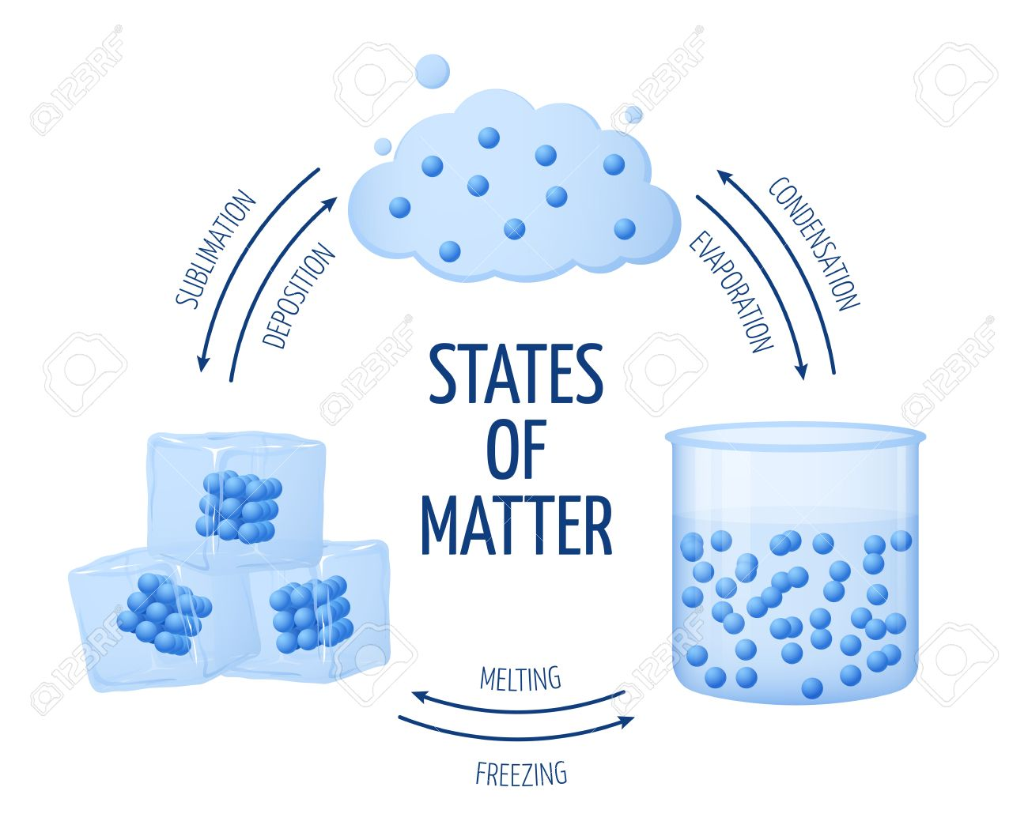

Physical and Chemical Changes
Physical change – does not alter the chemical composition e.g. metal alloy (tricky!)
Chemical change – changes the chemical composition by breaking and reforming bonds
C_{x}H_{y}(g) + α O₂ (g) --> β CO₂ (g) + γ H₂O (g)

Slide 10
The Scientific method
Universal tool for all scientific disciplines
Claim: Applicable to everyday life
How do I use the scientific method?
Gather observations – Qualitative (color, texture, temperature, etc.) and quantitative (measurable observable e.g. length and mass)
Generate hypothesis – Initial explanation for a phenomena
Test the hypothesis – gather data and observations
Determine whether to accept or reject hypothesis
If hypothesis is rejected, then reformulate the hypothesis (step 2)

Slide 11
Outline
Updated syllabus
Previous lecture - Classification and properties of Matter and Scientific Method
Ch. 1: Science and Measurements
Significant Digits
Making measurements in lab
Dimensional Analysis – Density and Temperature

Slide 12
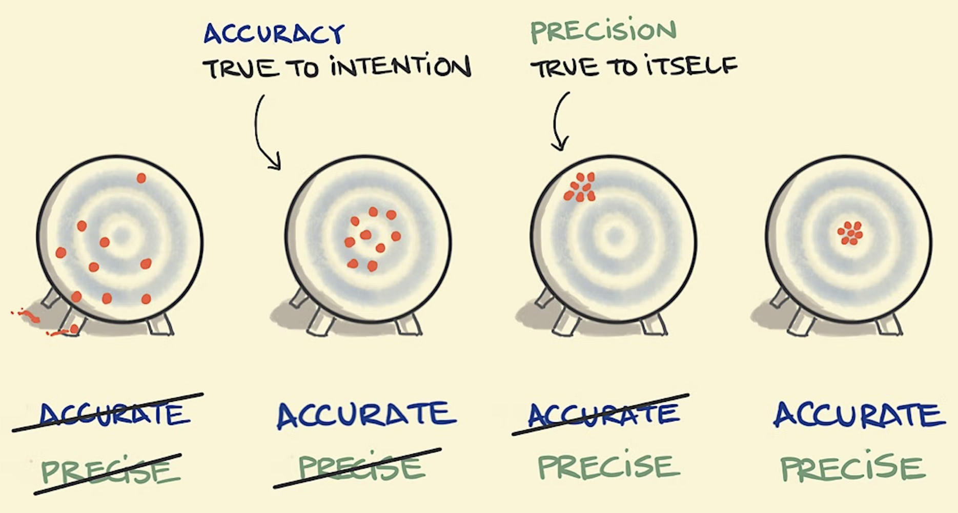
Significant digits
Recall qualitative and quantitative observations/data
Important when performing measurements. Implies a degree of accuracy and precision of the tool

Slide 13
Rules for significant digits
All nonzero digits are significant e.g. 1,039 has 4 signficant figures
Leading zeros such as 0.003, 0.01, etc are not significant
Sandwiched zeros – zeros between significant digits are significant e.g. 1,003
Trailing zeros – zeros to the right of all nonzero digits in a number are not significant unless there is a decimal e.g. 70,000 vs 70,000.
All digits in the coefficient of a number in scientific notation are significant

Slide 14
Sig. Figs.: addition and subtraction Rule
When adding or subtracting numbers, round the results to the fewest digit after the decimal based on the numbers being added or subtracted
Example:
6.2 cm + 9.203 cm = 15.4|03 cm = 15.4 cm
Side note: Importance of Units

Slide 15
Sig. Figs.: Multiplication and division rules
For multiplication and division, round the result based on the fewest significant figure based on the numbers being multiplied or divided
Example:
1.27 cm x 6.220 cm x 4.1 cm = 32.|38754 cm³ = 32 cm³

Slide 16
Sig. Figs.: Combining multiple operations
Keep track of the significant figures in each step
Example:
(80.21 g – 71.930 g)/65.2 cm³ = 8.28|0 g/62.5 cm³
= 0.132|48 g/cm³
= 0.132 g/cm³
(92.12 mL)(0.912 g/mL) + 223.02 g = 84.0|1344 g + 223.02 g
= 307.0|3344 = 307.0
= 307.0|3344 g = 307.0 g

Slide 17
Sig. Figs.: Combining multiple operations
Example:
1.41 x 10⁷ g + 3.56 x 10⁶ g = 1.41 x 10⁷ g + 0.356 x 10⁷ g
= 1.76|6 x 10⁷ g
= 1.77 x 10⁷ g
Your Turn:
(4.9 x 10³ g + 9.11 x 10² g)/220. cm³
(101.1 g – 98.31 g)/(38.92 mL – 1.97 mL)

Slide 18
Outline
Updated syllabus
Previous lecture - Classification and properties of Matter and Scientific Method
Ch. 1: Science and Measurements
Significant Digits
Making measurements in lab
Dimensional Analysis – Density and Temperature

Slide 19
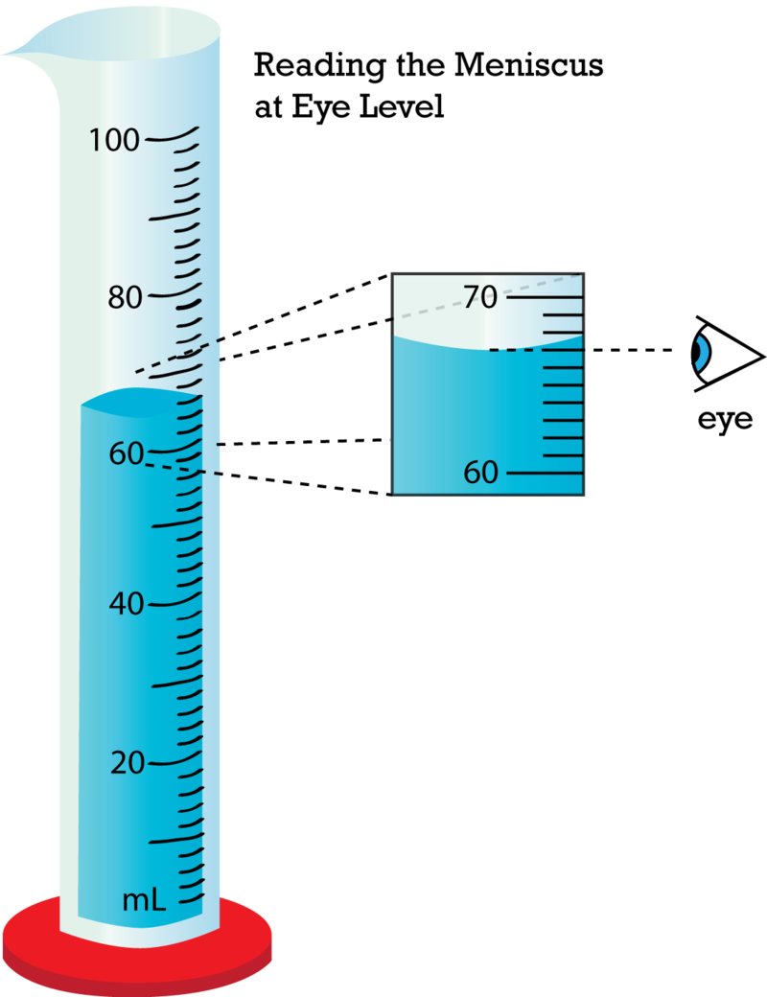
Making measurements in lab
67.0 mL

Slide 20
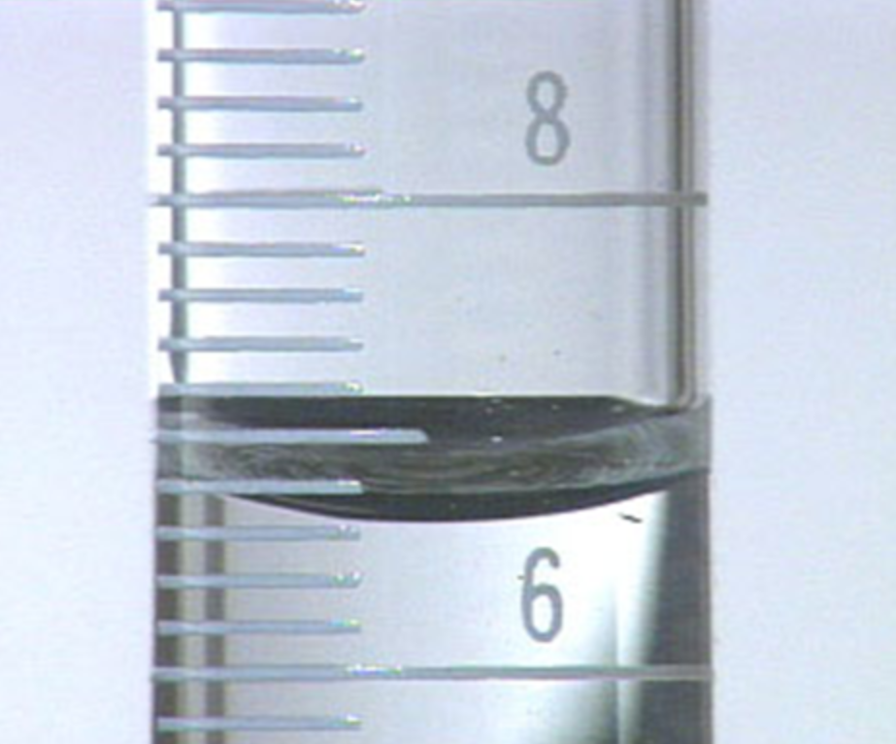
Making measurements in lab
6.32 mL

Slide 21
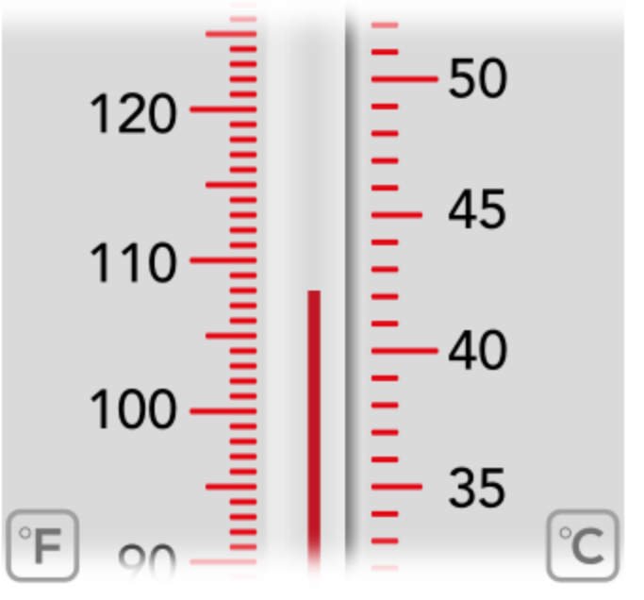
Your turn: Read the therometer

Slide 22
Outline
Updated syllabus
Previous lecture - Classification and properties of Matter and Scientific Method
Ch. 1: Science and Measurements
Significant Digits
Making measurements in lab
Dimensional Analysis – Density and Temperature

Slide 23
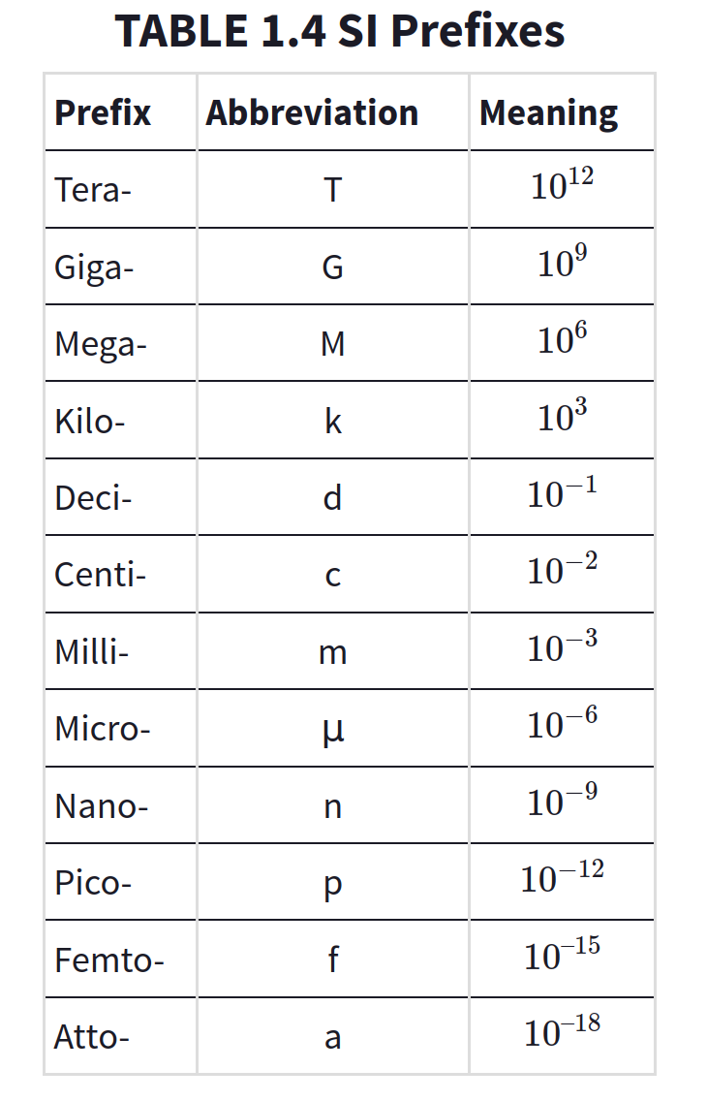
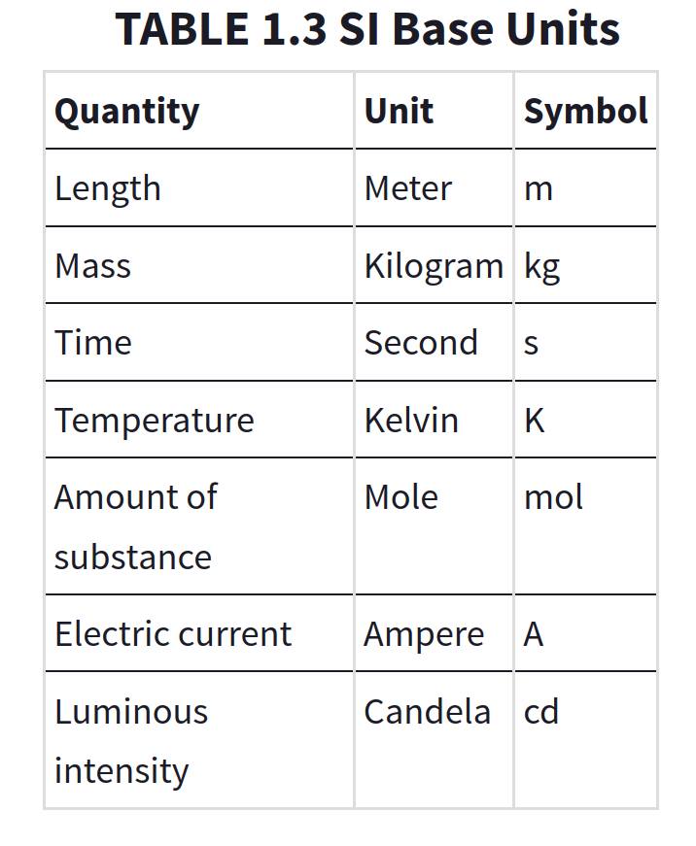
SI Base Units and Prefixes

Slide 24
SI Base Units and Prefixes
Unit for length (meters – m)
1 Gm = 1,000,000,000 m
1 Mm = 1,000,000 m
1 km = 1,000 m 1 m = 10 dm
1 m = 100 cm
1 m = 1,000 mm

Slide 25
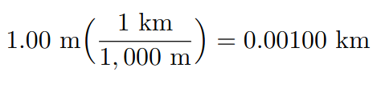
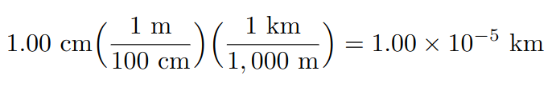
Dimensional analysis
Approach: Unit conversion is a ratio. Think about what units should be in the denominator and the numerator
Example:

Slide 26
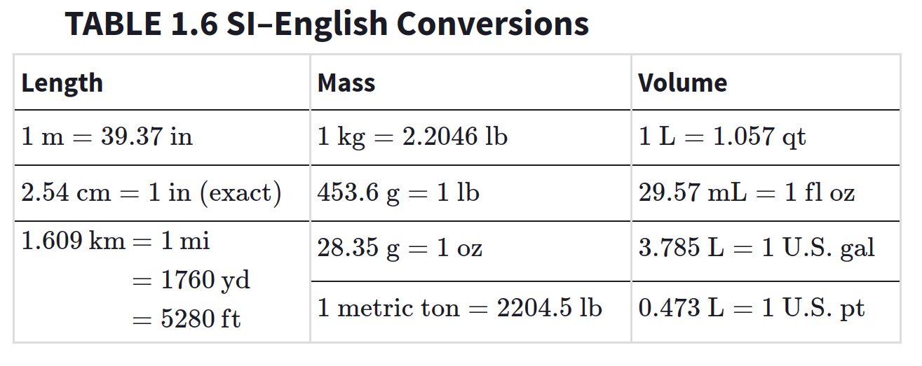
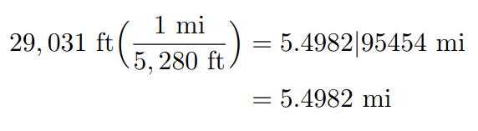
Dimensional analysis
Your Turn: Mount Everest is 29,031 ft high. Convert this to miles.

Slide 27
Density
Density – Measure of mass occupying space (g/mL)
Density = mass/volume
Temperature – Average kinetic energy of the atoms and molecule (°C, °F, or K)
T_{C} = (5/9)(T_{F} – 32)
T_{K} = T_{C} + 273.15

